Slide 1

HTML 5 Components – Button
SWEN661 – Spring 2021
Debashis Jena

Slide 2
Basics - <button …></button>
Used to create and define a clickable button on a document
Usually placed within a <form>
Can contain text as the value
Can have various types with the ”type” attribute

Slide 3
Attributes
value – specifies the initial text on the button
type – specifies the type; such as submit, reset and button
autofocus – Specifies that a button should automatically get focus when the page loads
disabled – Makes the button disabled / not clickable
formtarget – Specifies where to display the response after submitting the form. Only for type="submit”; example values = _blank, _self, _parent, _top
form – Specifies where to display the response after submitting the form. Only for type="submit"

Slide 4
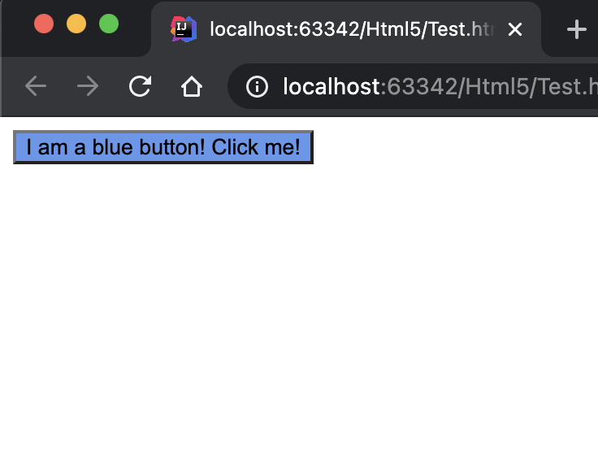
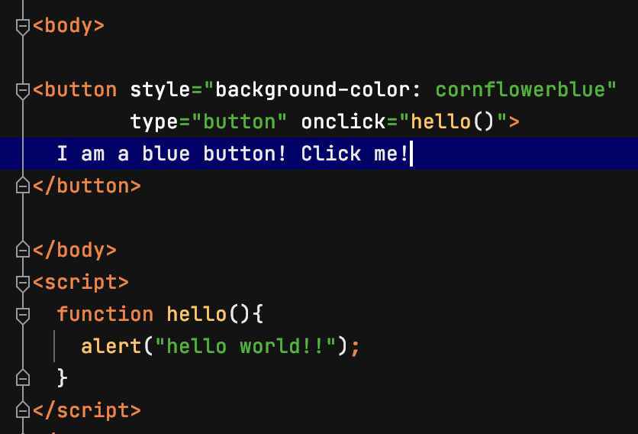
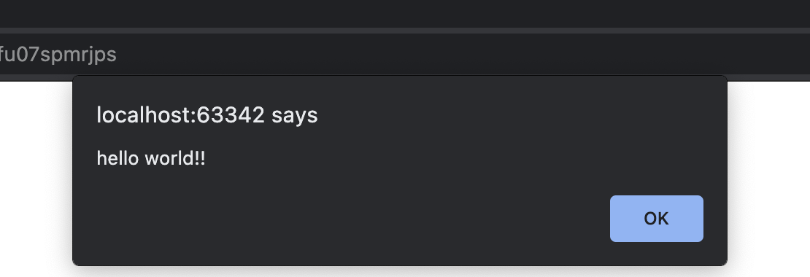
HTML 5 - <button></button>

Slide 5
Reference
No Author. (n.d.). HTML button tag. Retrieved from https://www.w3schools.com/tags/tag_button.asp.
No Author. (n.d.). HTML cheatsheet. Retrieved from https://hostingcanada.org/html-cheat-sheet/#forms

